Slide 1



INSE 6120 Cryptographic Protocols and Network Security Cybersecurity Assessment of CAN Networks and Alternatives: A Comprehensive Survey on Recent Attacks and Resource Requirement
Group 10
Prof: Dr. Ivan Pustogarov

Slide 2

Introduction
Automotive control networks are digitally connected systems in modern vehicles that oversee critical functions. As connectivity and automation increase, the security of in-vehicle control networks becomes a paramount concern. Potential cyber-attacks on these networks can compromise privacy and jeopardize vehicle safety. This survey analyzes recent attacks on automotive networks to identify vulnerabilities and quantify resource requirements.

Slide 3
Overview of Automotive Networks
Automotive networks connect electronic control units (ECUs) within a vehicle. Controller Area Network (CAN) is the backbone, facilitating real-time data exchange for critical functions. Alternative protocols like Local Interconnect Network (LIN) and FlexRay cater to specific requirements. Securing these networks against cyber threats is a central challenge. Vulnerabilities could lead to unauthorized access, data manipulation, or system compromise.

Slide 4
Overview of CAN,LIN and FlexRay Networks
CAN
CAN is commonly used for in-vehicle networking, connecting various ECUs such as engine control units, transmission control units, and more.
LIN
It is often used for less critical functions where lower data rates are acceptable. LIN is commonly used for functions like window lifts, sunroofs, mirror adjustment, and other non-critical systems.
FLEX RAY
Used for critical systems where high reliability and real-time communication are essential, such as in advanced driver assistance systems, braking systems, and steer-by-wire applications.

Slide 5
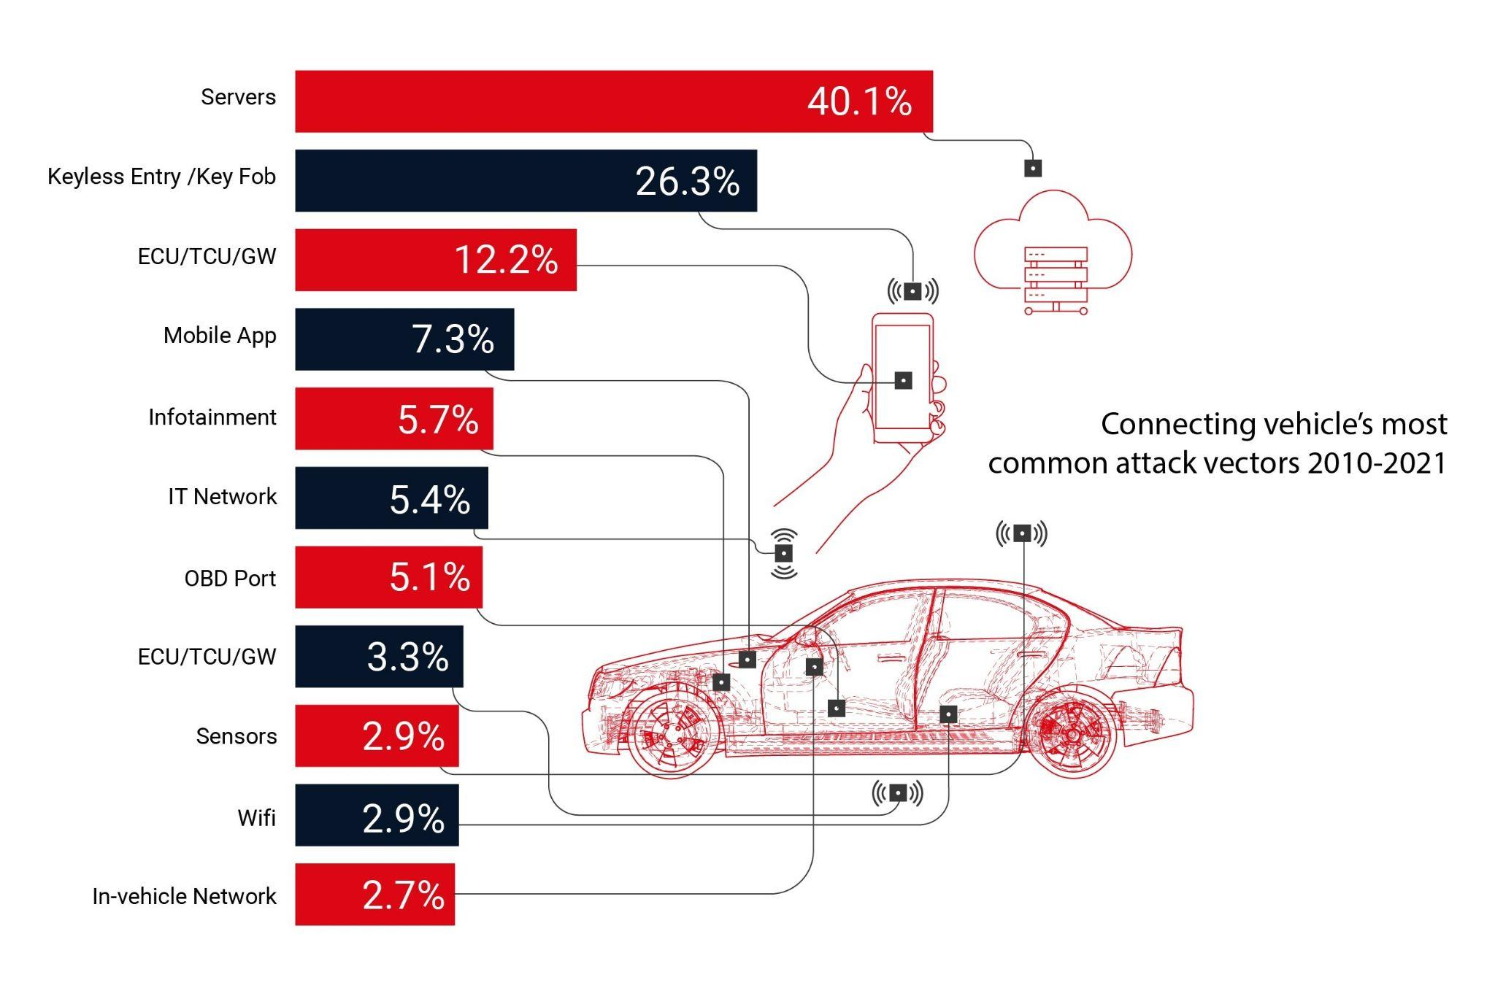
Notable Attacks on Automotive Networks
Real-world examples include lock picking attacks on keyless entry systems, TPMS exploitation, and road infrastructure attacks.
Specific vulnerabilities in the CAN bus system, such as the Jeep hack via cellular network, highlight the dangers of remote attacks.
Other attacks include manipulation via the OBD-II port, selective DoS attacks, and vulnerabilities in industry standards.
Enhanced security measures are critical to mitigate evolving attack surfaces and potential consequences.

Slide 6
ATTACKS ON IN - VEHICLE NETWORK SYSTEM
Lock Picking Attack on Keyless Entry Systems
Replay Attack
Manipulation via OBD-II Port
TPMS (Tire Pressure Monitoring System) Exploitation
ECU Impersonation
Attack through a Malicious App
Road Infrastructure Attacks
Jeep Hack via Cellular Network
Selective Denial-of-Service (DoS) Attack

Slide 7
Computational and Communication Resources
CAN bus dataset
Test data were collected from a branded vehicle's CAN network using Vehicle Spy simulation test software.
Data were captured from the On-Board Diagnostics (OBD) port to construct a dataset, ensuring no adverse effects from packet loss.
44 datasets were created, each with one million messages, and sorted based on CAN IDs.
Messages' hexadecimal values were converted to a uniform length data field for analysis.
An anomaly detection algorithm was applied separately to each CAN ID's message stream to identify potential tampering.

Slide 8
Continued…
Various connectivity interfaces in modern vehicles, such as Bluetooth, Wi-Fi, cellular networks, OBD-2, GPS, CD players, sensors, LiDAR, cameras, and keyless entry systems, pose potential cybersecurity risks. Bluetooth connections, often with legacy and vulnerable versions, can lead to security vulnerabilities. Wi-Fi in connected cars has vulnerabilities, as demonstrated through attacks on Wi-Fi hotspots in vehicles. Cellular networks in cars can be exploited for data retrieval, but they are also susceptible to attacks, as shown in instances where the cellular network interface in a Jeep was hacked.
OBD-2 ports, used for diagnostics, are vulnerable to attacks, including those initiated through aftermarket OBD dongles, leading to potential safety risks. GPS interfaces, vital for driving assistance and fleet management, can serve as entry points for attackers, allowing data injection and sniffing. CD players, connected to a vehicle's internal data network, are susceptible to cyberattacks.

Slide 9
Continued…
Sensors and actuators, crucial for various vehicle functions, can be targeted through physical availability attacks such as signal jamming, leading to potential manipulation of sensor data. Specific sensors, like those for Tire Pressure System Monitoring (TPSM), have been exploited through eavesdropping attacks.
LiDAR and camera systems, designed for safety and driving assistance, are vulnerable to signal jamming attacks. Keyless entry systems, responsible for remotely locking/unlocking vehicle doors, have been a common target. Attacks on keyless entry involve signal jamming, capturing key fob signals, and relay signal attacks. These attacks can result in unauthorized access to vehicles, posing a significant security threat.

Slide 10
Advanced Automotive Security Measures
Encryption:
Implementing lightweight encryption systems as the CAN protocol lacks built-in encryption.
Dynamic key exchange is essential but presents performance and latency challenges for ECUs.
Secure Boot:
Ensuring only software with valid signatures boots, using UEFI mechanisms.
Effective but not infallible due to past vulnerabilities in specific implementations.
Firewall Gateway:
Implementing firewalls within network gateways, based on ECU certifications and specific vehicular subnet authorizations.
Prevents less critical networks from accessing higher safety-relevant systems.
Honeypots:
Using decoy systems to study attackers' behaviors and develop robust security measures.
Collects data on attack patterns and tactics, aiding in future security enhancements​​.
Network Segmentation:
Dividing the CAN network into subnetworks to control access and limit attack spread.
Utilizes a gateway ECU to manage interconnections but vulnerable if the gateway ECU is compromised.

Slide 11

CONCLUSION
In conclusion, the vulnerabilities of current malware detection methods in intelligent vehicles pose a substantial threat to passenger safety. Evasion techniques, such as multi-ECU throttling and multi-core processor utilization, highlight the need for more robust detection mechanisms. Traditional approaches struggle to identify new, sophisticated malware and face challenges in regular updates over a vehicle's lifespan. Cloud-based solutions, especially with high-speed 5G technology, emerge as a promising solution, providing adaptability and efficiency in countering evolving threats. Prioritizing the integration of advanced, cloud-based detection systems is crucial for ensuring ongoing security in the era of intelligent vehicles.

Slide 12
Thank You!
Student Name | Student ID
Deep Bhavesh Gajiwala | 40231725
Devina Shah | 40238009
Karanjot Singh | 40220861
Meet Rakeshbhai Patel | 40239187
Rohan Yogeshkumar Modi | 40255454
Pratiksha Ashok Kumar Pole | 40230412
Saket Suman | 40225128
Simran Kaur | 40241517
Snehpreet Kaur | 40254443

